Slide 1
State of the Engineering Economy
May 2025

Slide 2
How is the U.S. Economy Doing?

Slide 3
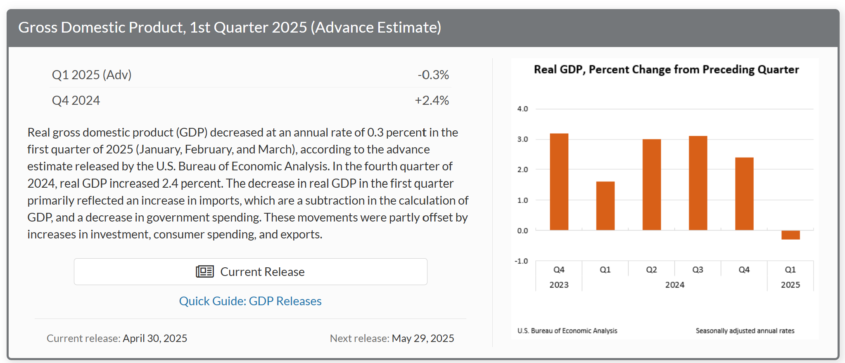
U.S. GDP contracts for first time in three years.
Source: Bureau of Economic Analysis
Notes:
Source: https://www.bea.gov/data/gdp/gross-domestic-product

Slide 4
U.S. job growth is slowing, unemployment steady.
Unemployment Rate (%)
Source: U.S. Bureau of Labor Statistics
Notes:
Average monthly employment slowing…234K in 2023, 179 in 2024, 144 in 2025 so far
And unemployment rate still very low, but three months of increases.
Employment is based on the “Current Employment Statistics” conducted by the Bureau of Labor Statistics and represents a divergence from the “Current Population Survey” conducted by the BLS which shows fewer job gains.
Source: https://www.bls.gov/regions/mid-atlantic/data/xg-tables/ro3fx9584.htm
Although consumer debt is at all time high, as a percentage of disposable income, is at 11.5% and slightly below levels of past 12 years.
Total household debt rose by $109 billion to reach $17.80 trillion, according to the latest Quarterly Report on Household Debt and Credit. Mortgage balances were up $77 billion to reach $12.52 trillion, while auto loans increased by $10 billion to reach $1.63 trillion and credit card balances increased by $27 billion to reach $1.14 trillion. The volume of mortgage originations remained low, primarily due to subdued refinancing activity. Homeowners continued to increase balances on home equity lines of credit (HELOC) as an alternative way to extract home equity; HELOC limits rose by $3 billion, marking the ninth consecutive quarterly increase. Aggregate delinquency rates remained unchanged from the previous quarter, with 3.2 percent of outstanding debt in some stage of delinquency.
Source: https://www.newyorkfed.org/microeconomics/hhdc
Source: https://fred.stlouisfed.org/series/TDSP

Slide 5
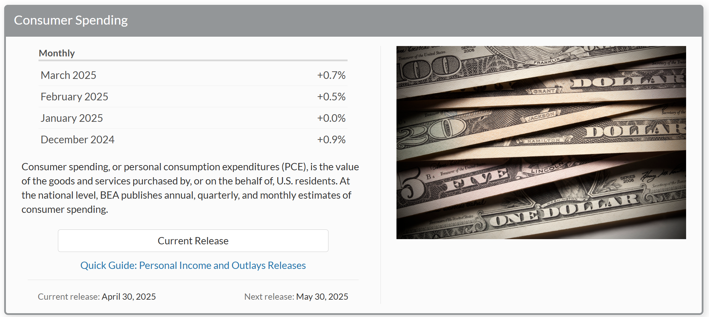
Consumer spending strong in 2025 so far…
Source: U.S. Bureau of Economic Analysis
Notes:
PCE Price Index still shows inflation nearing 2% target but getting close. Nov – 2.7%, Dec. – 2.6%, Jan. – 2.5%, Feb. – 2.5%, Mar. – 2.7%, Apr – 2.7, May – 2.6, Jun – 2.4, Jul 2.5%, Aug. 2.3%, Sept 2.1%, Oct. 2.3, Nov. 2.5, Dec 2.6%, Jan. 2.6%, Feb. 2.7%, March 2.3% (core 2.6%)
Source: https://www.bea.gov/data/consumer-spending/main

Slide 6
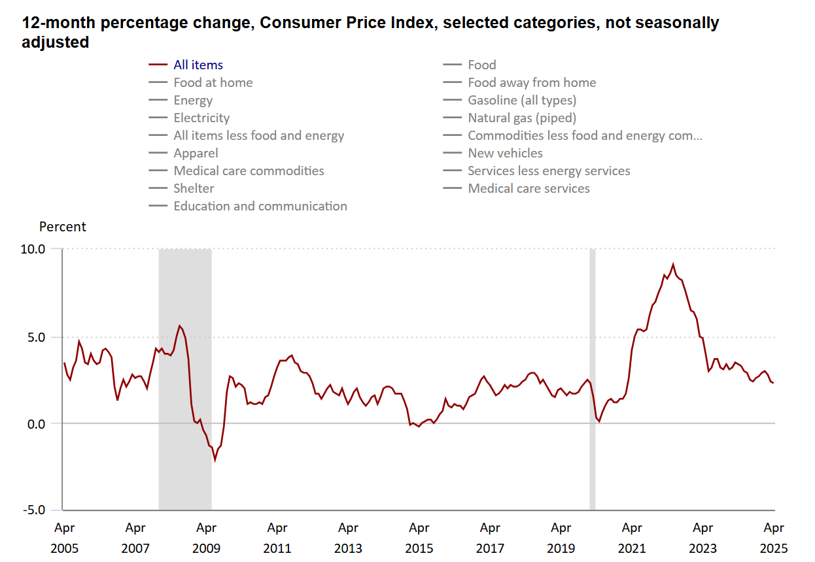
Headline inflation falls in April to lowest level in four years, but still not at target.
All items
June 2022: 9.1%
All items
Apr. 2025: 2.3%
All items
June 2023: 3.0%
All items
Sept. 2024: 2.4%
Source: U.S. Bureau of Labor Statistics
Notes:
Inflation topped out at June 9.1%, but fell for the next 12 months… to 3.0% in June 2023 then started to go sideways
Height of inflation during financial crisis was 5.6% in July 2008 - we hit 5.4% in June 2021.
Core fell to 2.8% in April, also lowest in four years but still well above target of 2%.
Source: https://www.bls.gov/charts/consumer-price-index/consumer-price-index-by-category-line-chart.htm

Slide 7
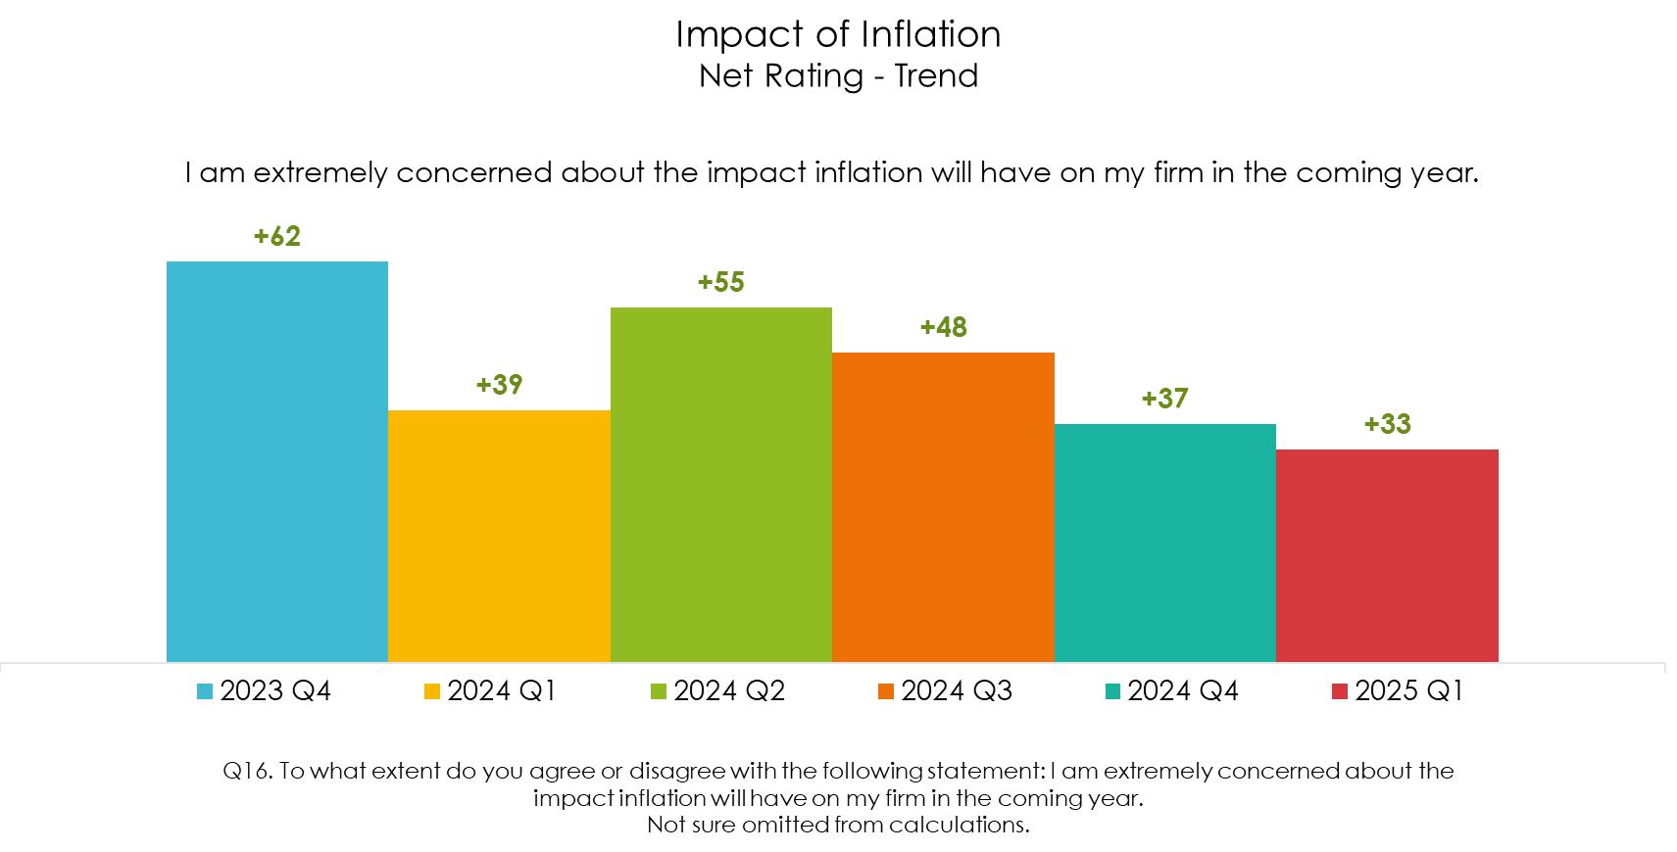
Inflation concerns fall to new low in Jan.
Source: ACEC Research Institute, Engineering Business Sentiment – 2025 Q1
Notes:
The high was +85 in Q2 2022.

Slide 8
How is the A/E Industry Doing?

Slide 9
2024 Q4 A/E revenues continue to reach new (nominal) highs.
A/E Total Services Revenue = $124.3B for 2024 Q4
Total revenues up 4.2% compared to Q3 2024
Total revenues up 11.7% YoY
Source: U.S. Census Quarterly Services Survey, March 2025

Slide 10
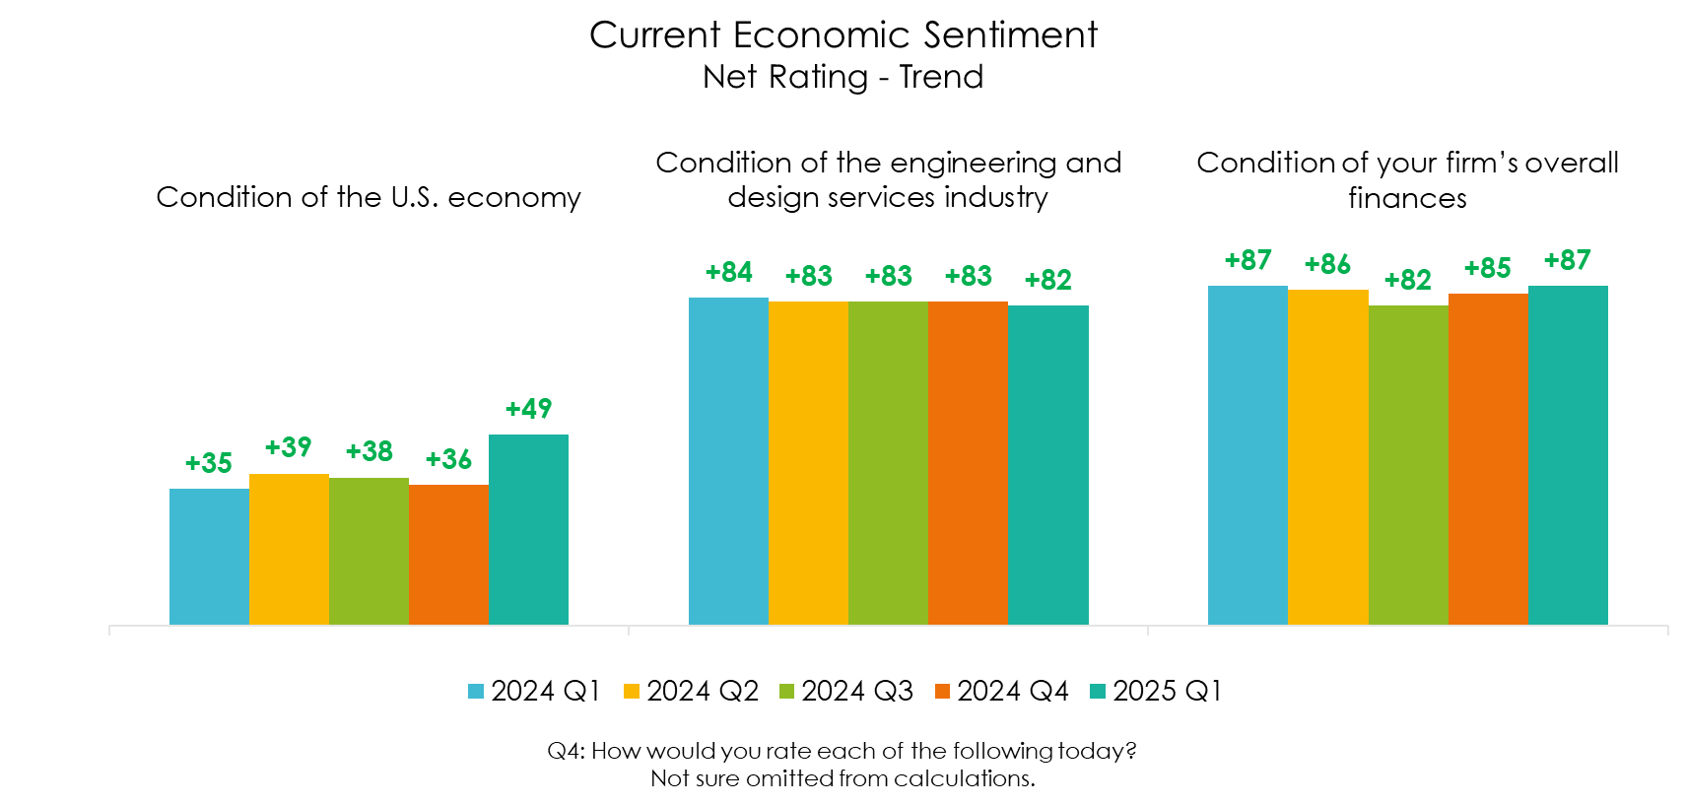
Sentiment regarding U.S. economy hits all-time high.
Source: ACEC Research Institute, Engineering Business Sentiment – 2025 Q1
Notes:
US Economic Sentiment hit previous high point in Q4 2021 at +40. Low of -15 in 2022 Q3.

Slide 11
Midwest has similar levels of optimism.
Current Economic Sentiment
Net Rating by Segment
Condition of the U.S. economy | 2024 Q1 (n=562) | 2024 Q2 (n=640) | 2024 Q3 (n=627) | 2024 Q4 (n=569) | 2025 Q1 (n=637) | Change vs. Previous Quarter | Change vs. Previous Year
TOTAL | +35 | +39 | +38 | +36 | +49 | +13 | +14
REGION
Northeast | +43 | +54 | +53 | +45 | +50 | +5 | +7
South | +24 | +35 | +29 | +21 | +47 | +26 | +23
Midwest | +44 | +40 | +41 | +47 | +50 | +3 | +6
West | +33 | +33 | +35 | +36 | +53 | +17 | +20
FIRM SIZE
1-25 | +23 | +27 | +24 | +26 | +35 | +9 | +12
26-50 | +32 | +34 | +30 | +23 | +44 | +21 | +12
51-200 | +37 | +37 | +44 | +33 | +53 | +20 | +16
201-500 | +36 | +54 | +44 | +40 | +54 | +14 | +18
More than 500 | +49 | +51 | +46 | +54 | +59 | +5 | +10
Q4: How would you rate each of the following today? Not sure omitted from calculations.
Source: ACEC Research Institute, Engineering Business Sentiment – 2025 Q1

Slide 12
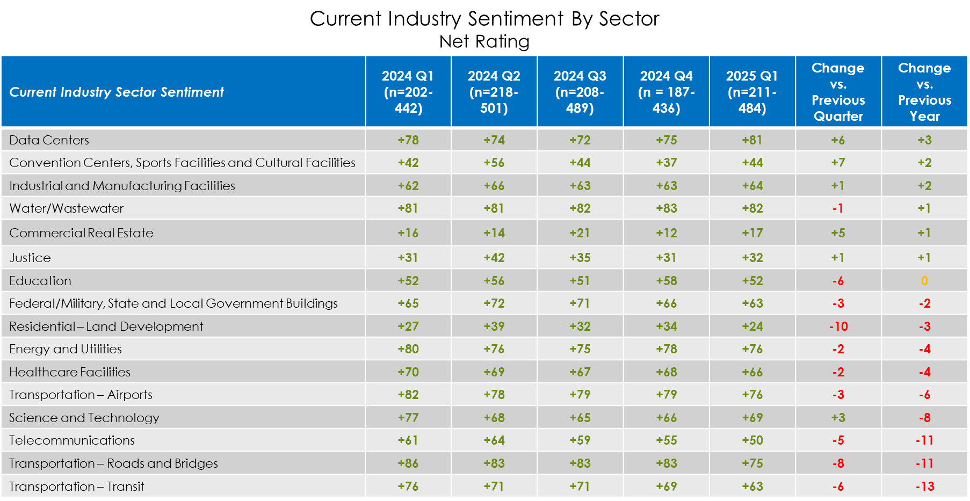
Sector sentiment remains positive, although some have improved and some declined.

Slide 13
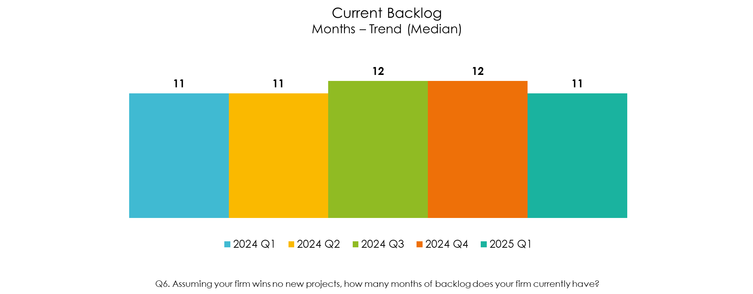
Backlog remains strong and steady.
Source: ACEC Research Institute, Engineering Business Sentiment – 2025 Q1
Notes:
Northeast has been steady at 12 months for at least the past year.

Slide 14
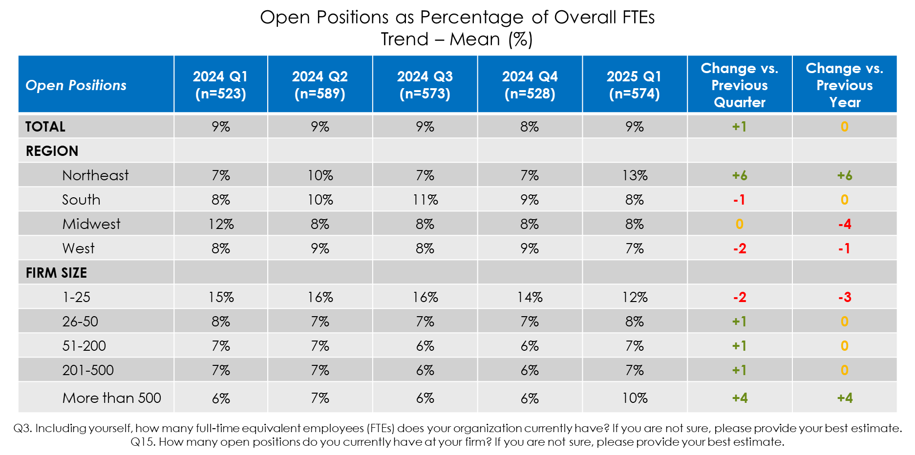
Nearly one out of ten positions remain open.
Source: ACEC Research Institute, Engineering Business Sentiment – 2025 Q1

Slide 15
What Does the Future Hold?

Slide 16
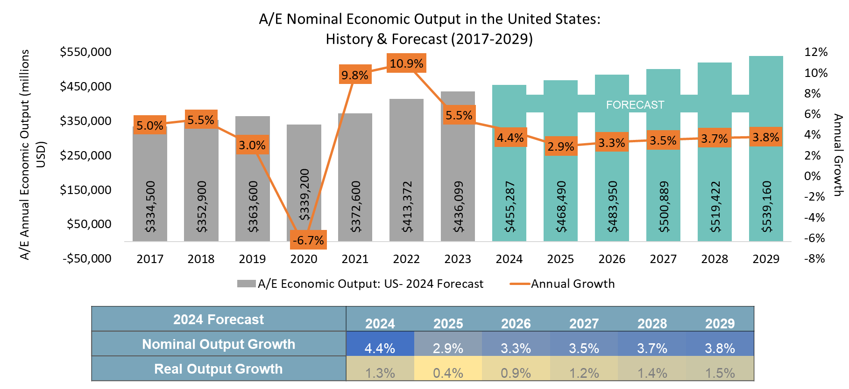
Growth will continue to moderate into 2025.
Source: ACEC Research Institute

Slide 17
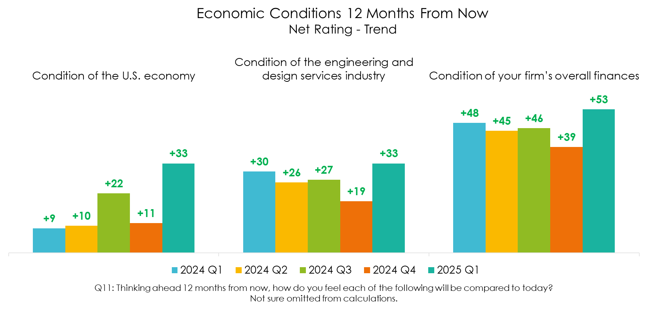
Future sentiment jumps to new highs.
Source: ACEC Research Institute, Engineering Business Sentiment – 2025 Q1
Notes:
- Low point for U.S. economy sentiment was Q3 2022 at -40.

Slide 18
Midwest increased by 15 points over Q4.
Economic Conditions 12 Months From Now
Net Rating by Segment
Condition of the U.S. economy | 2024 Q1 (n=510) | 2024 Q2 (n=579) | 2024 Q3 (n=543) | 2024 Q4 (n=491) | 2025 Q1 (n=571) | Change vs. Previous Quarter | Change vs. Previous Year
TOTAL | +9 | +10 | +22 | +11 | +33 | +22 | +24
REGION
Northeast | +18 | +17 | +28 | +20 | +37 | +17 | +19
South | +10 | +8 | +24 | +7 | +46 | +39 | +36
Midwest | +6 | +9 | +29 | +9 | +24 | +15 | +18
West | +2 | +12 | +9 | +14 | +21 | +7 | +19
FIRM SIZE
1-25 | +1 | +6 | +11 | 0 | +28 | +28 | +27
26-50 | +10 | +18 | +1 | +3 | +22 | +19 | +12
51-200 | +9 | +9 | +30 | +21 | +33 | +12 | +24
201-500 | +12 | +3 | +42 | +15 | +43 | +28 | +31
More than 500 | +18 | +18 | +28 | +13 | +37 | +24 | +19
Q11: Thinking ahead 12 months from now, how do you feel each of the following will be compared to today?
Not sure omitted from calculations.
Source: ACEC Research Institute, Engineering Business Sentiment – 2025 Q1

Slide 19
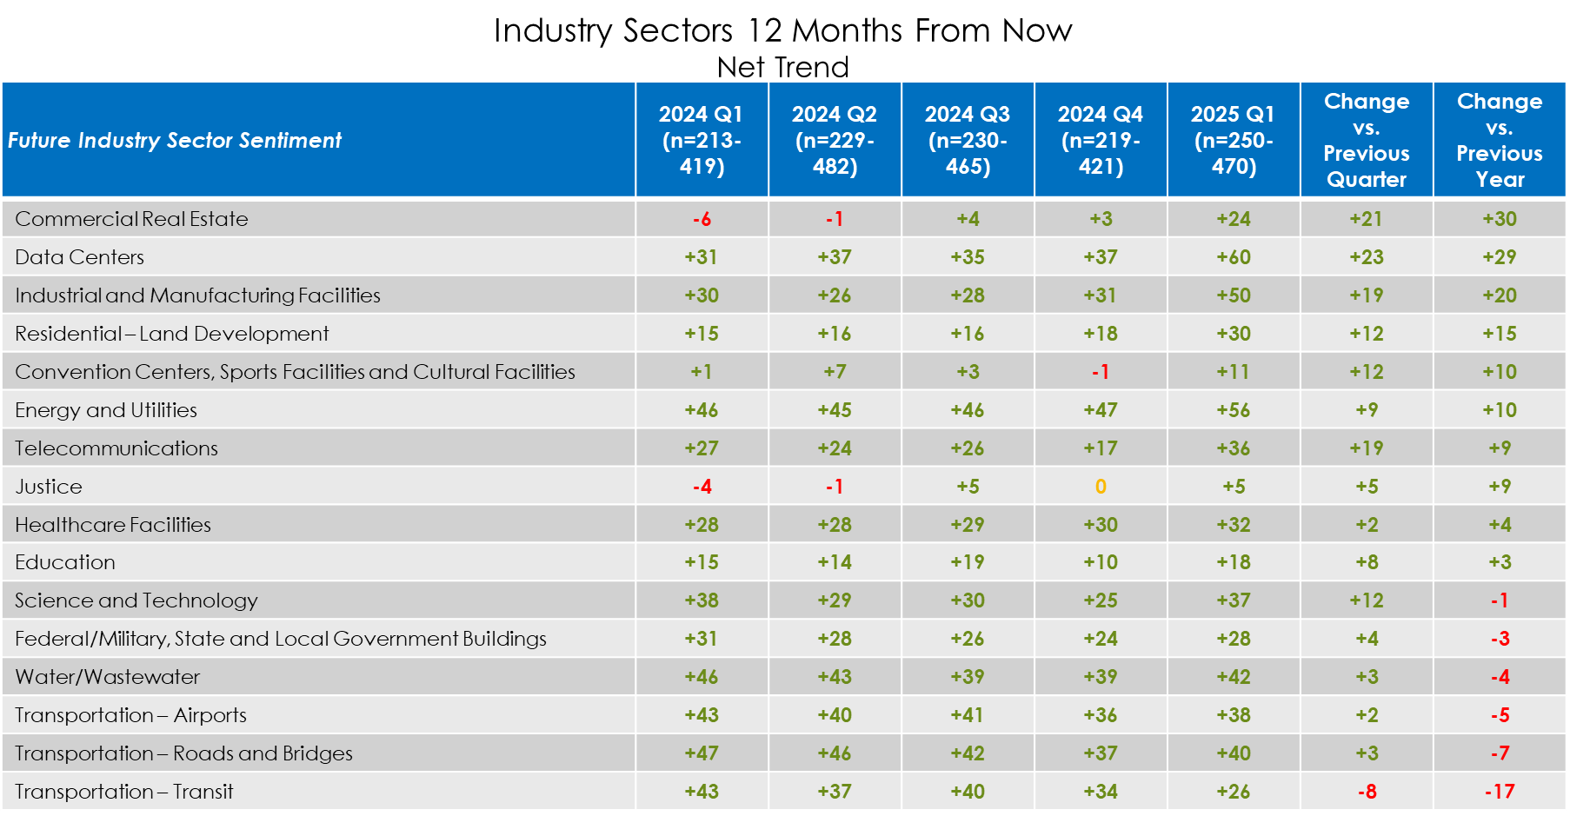
Sector sentiment increases across the board.

Slide 20
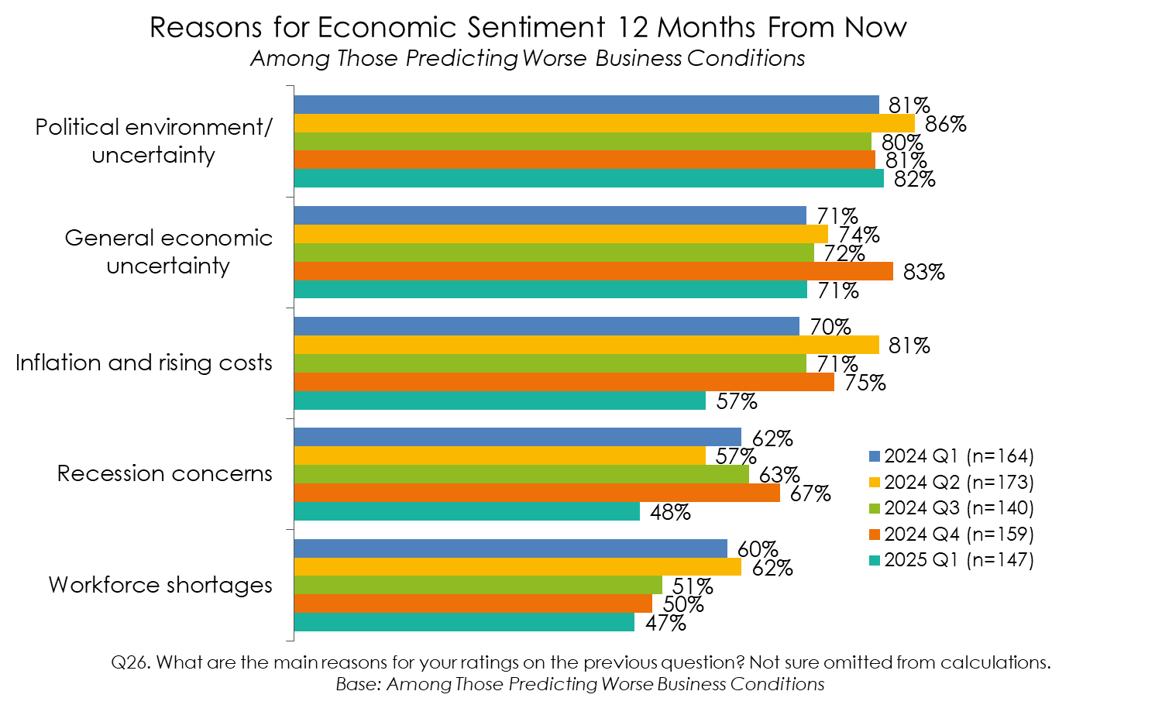
Political environment/uncertainty driving negative sentiment.
Source: ACEC Research Institute, Engineering Business Sentiment – 2025 Q1

Slide 21
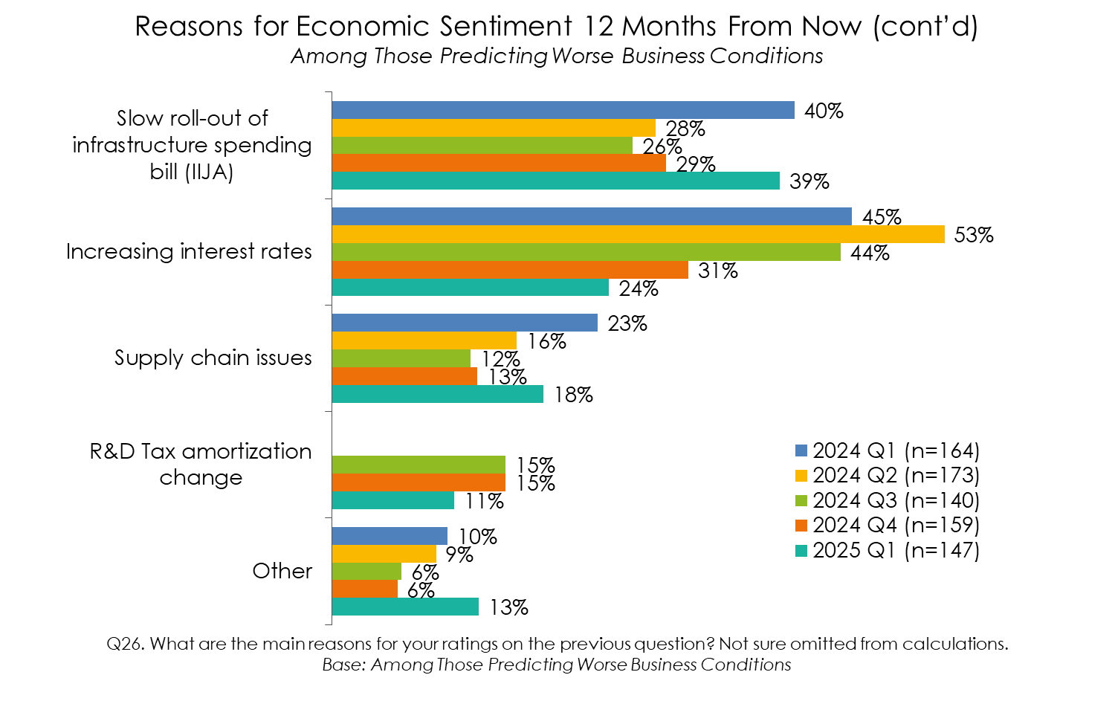
Concern regarding slow roll-out of IIJA jumps.
Source: ACEC Research Institute, Engineering Business Sentiment – 2025 Q1

Slide 22
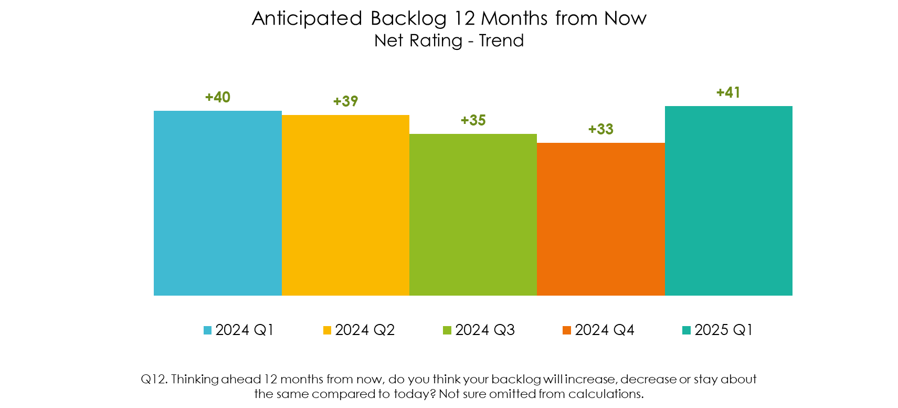
Future backlog sentiment improves markedly.
Source: ACEC Research Institute, Engineering Business Sentiment – 2025 Q1

Slide 23
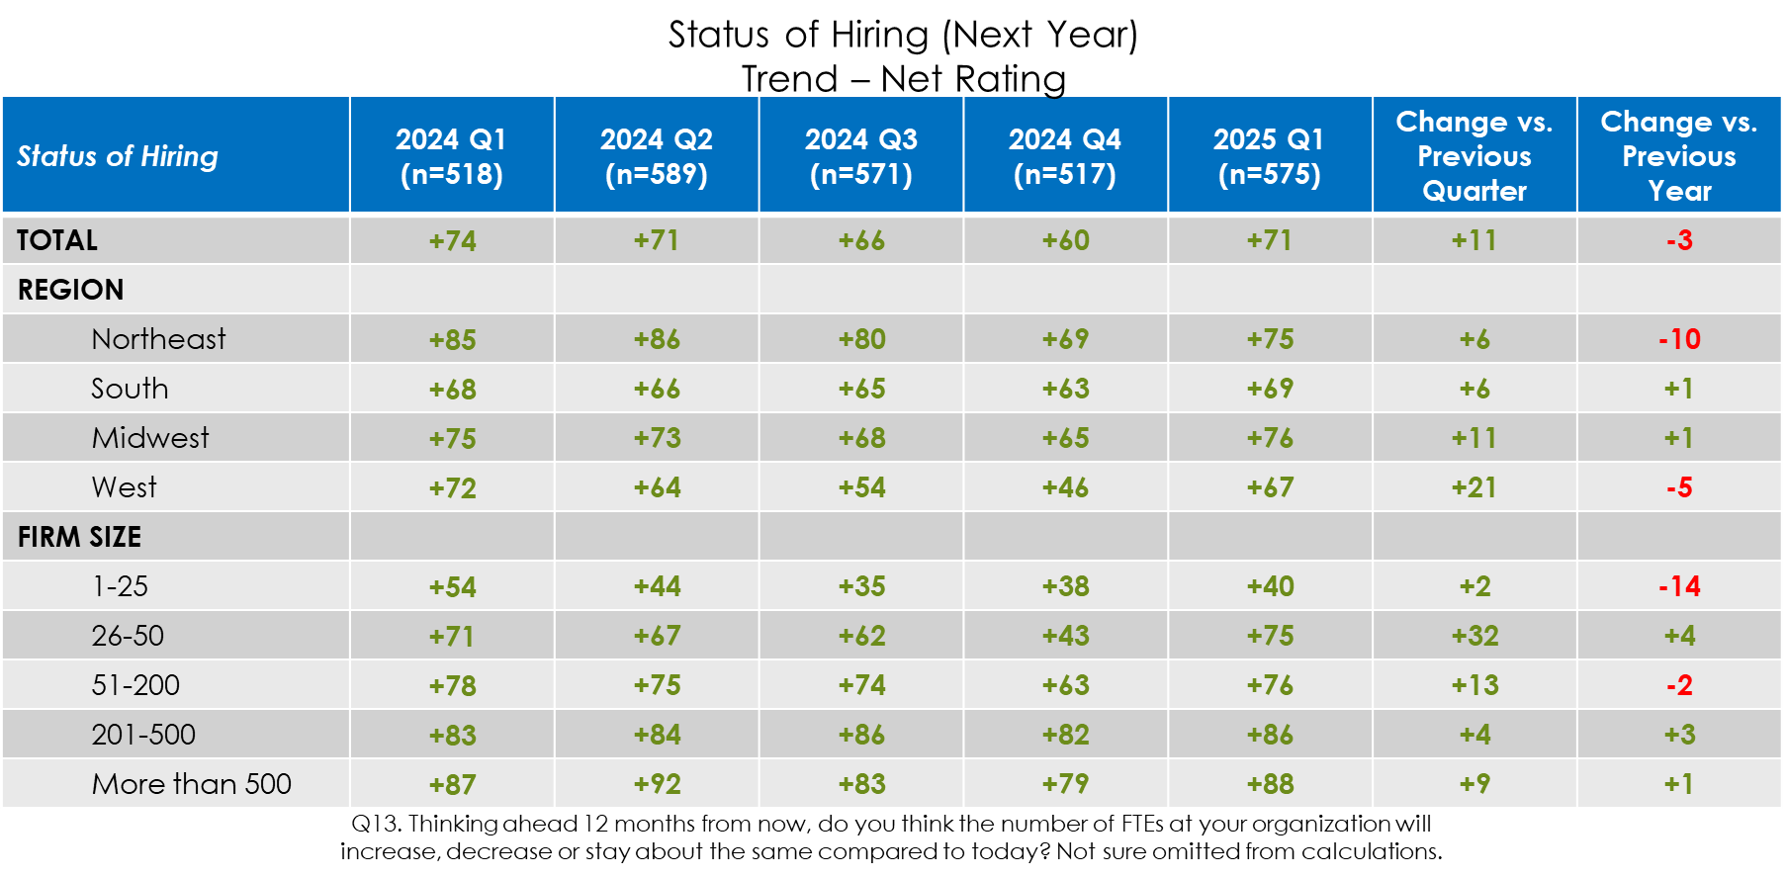
Future hiring sentiment rebounds.
Source: ACEC Research Institute, Engineering Business Sentiment – 2025 Q1

Slide 24
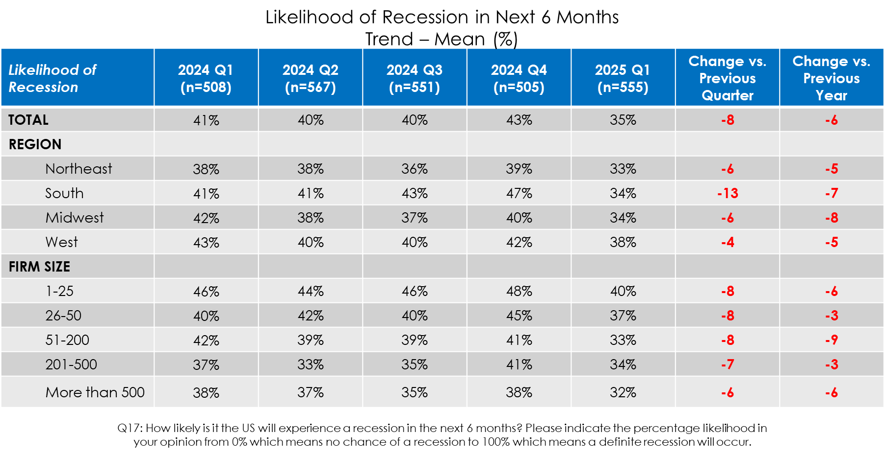
Recession concerns recede significantly.
Source: ACEC Research Institute, Engineering Business Sentiment – 2025 Q1

Slide 25
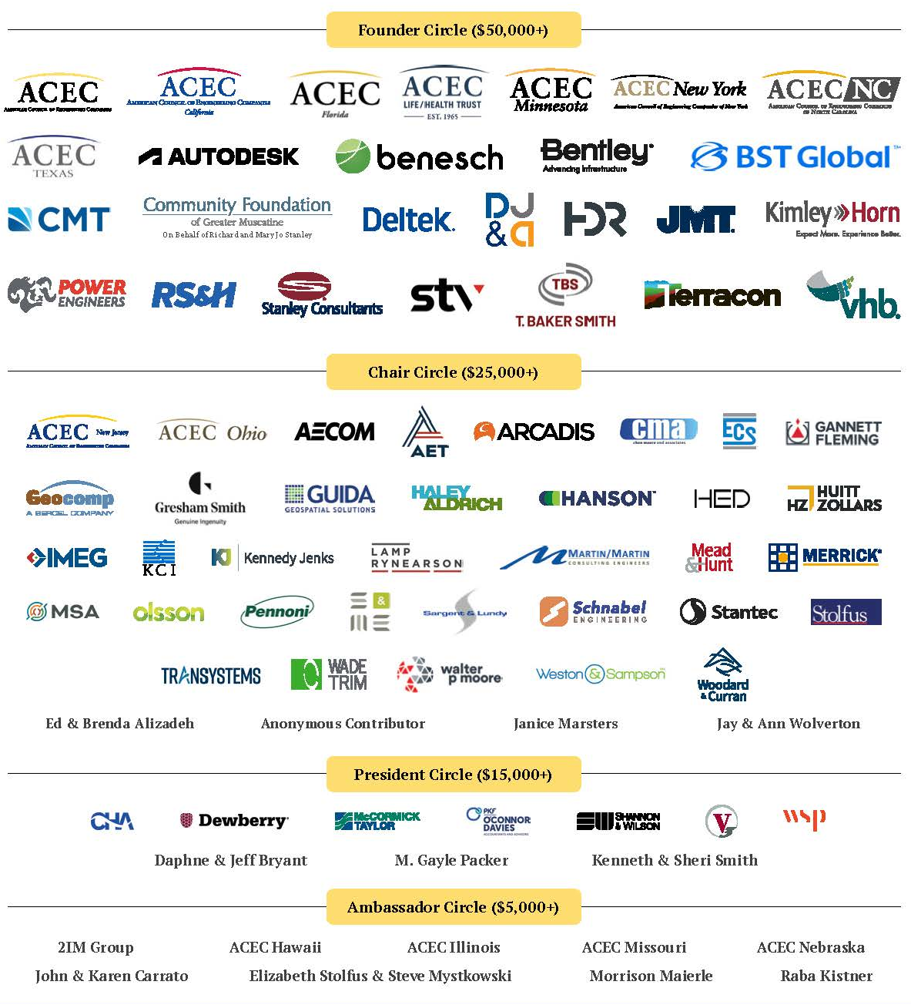
Thank you to our donors for making this research possible!

Slide 26
Providing Engineering Services
Using Lump Sum Contracts:
A Study on Opportunities and Challenges
May 2025

Slide 27
Study Objectives
Determine the advantages and disadvantages of lump sum arrangements from client and engineering firm perspectives
Capture current practices associated with utilization of lump sum commercial structures
Identify opportunities and barriers for wide-spread implementation

Slide 28
Client and Firm Interviews
Client and Firm Interviews
14 state and federal clients
9 industry firm executives
Each with 20+ years of experience
Notes:
Conducted in depth, one on one interviews
14 clients, state and federal, including DOTs, Army Corps of Engineers and Federal Lands
Chief Engineers and Chief Procurement Officers
9 firms
All sizes, small 10 person in one state to large national firms with thousands of employees
CEO, COO, Transportation leads
All had 20+ years experience ( a very representative sample of the industry)

Slide 29
Utilization of Lump Sum for Engineering and Design Services
Range for Client Organizations
40% Limited use (< 10% – exception)
20% Moderate use: (25-50%)
40% Extensive use: (80% or more – rule)
Range for Engineering Firms
Approximately 20% to 80% of business
Very dependent on firm size, regions served and client types
Utilization of Lump Sum for Engineering and Design Services
Notes:
Range of uses from very limited to extensive
We are starting to see the transition ( but it is slow and we need to accelerate change) for
Both firms and clients

Slide 30
Types of Services Suitable for Lump Sum Contracts
Nearly All

Slide 31
Projects Most Suitable…and Least
Most Suitable:
Resurfacing, restoration and rehabilitation
Interchange/intersection improvements, bridge inspection, culvert replacement
Least Suitable:
Complex projects with “unknown unknowns”
Significant engagement with third parties
Complex MOT (Maintenance of Traffic)

Slide 32
Impact of Emerging Technology
Technologies will continue to evolve and impact how engineering and design services are performed.
Firms experience high overhead costs when technologies advance or change – unclear whether clients fully recognize this.
AI emergence remains “uncharted territory” for many client organizations.

Slide 33
“We all have to figure out how to address the AI component of [engineering services]. And lump sum seems to be a very good solution to address the commercial arrangement that is going to be needed as we move into more automation, AI type delivery, because there's still human intervention in this. Somebody still has to select, somebody still is going to come up with ideas that haven't been thought of, things like that. And that's where the real value gets created.”
-Engineering Firm Executive

Slide 34
Lump Sum in Client Organizations
Advantages
Increased efficiency for design services, creates incentives for consultants to control costs, reduces time and costs of invoicing.
Provides firms flexibility to adjust staff.
Greater focus on product/deliverable rather than administration and invoicing process.
Better alignment about scope and price between client and consultant due early dialogue and negotiations.
Disadvantages
Client’s project manager is not monitoring deliverables sufficiently.
Significant up-front time and effort in establishing scope of services and price, which may not be practical in all cases.
Inexperience of client staff to manage lump sum contracts.
Changes or modifications require renegotiation of scope of services and pricing that may prove more challenging.

Slide 35
“Lump sum is a payment method whereby a consultant is paid a specified sum of money for a specific service in the contract. With this payment method the compensation is not subject to any adjustment due to cost changes that the consultant encounters in performance of the work unless substantive changes occur in the scope of services. Because the consultant assumes full responsibility in the form of profits or losses, this method provides a maximum incentive for effective cost control in contract performance. This type of payment method imposes the minimum administrative burden on both the consultant and INDOT. This method should only be used when the estimate, duration of effort and project scope is defined to the extent that fair and reasonable compensation can be determined.”
-INDOT Professional Services Contract Administration Manual

Slide 36
Observations and Insights
Start incrementally and consider phasing services.
Select when services or project is suitable, and both parties can fully agree on scope of work.
Lump sum contracting is not a loss of control for the owner since scope is mutually agreed at the start.
Consultants are fiduciaries of their clients, so shift to lump sum doesn’t change standard of care or liability.

Slide 37
“I'm sure if we asked some of our agency project managers, they may not even know that lump sum contracting is a tool that they can use. So that education awareness within the agency is not quite there yet. And then getting them interested in understanding the benefits and then being able to provide the infrastructure such as training and support. So not a lot of that exists. And so it would be transitioning that body of work and program to a place where we now have a program that supports lump sum. We just haven't taken that step yet.”
-State DOT Official

Slide 38
Thank you!

Slide 39
Download the Full Reports
Engineering Business Sentiment Q1 2025
Provision of Engineering Services on a Lump Sum Basis Sum Study

